Slide 1
Software Error & Bug Report
Ha Nguyen

Slide 2







Agenda
What is a Software Error?
Common Sources of Errors
Common Types of Software Errors
Reproducing and Analyzing a Software Error
Reporting a Software Error – Bug report
Bug Report Sample
Defect Life Cycle

Slide 3

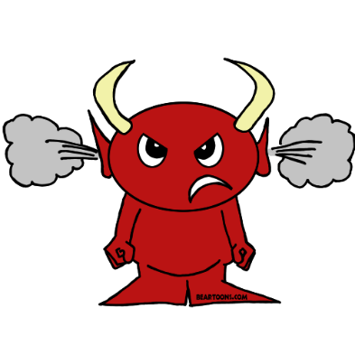
What is Software Error?
A software error is present when the program does not do what its user reasonably expects it to do.
It is fair and reasonable to report any deviation from high quality as a software error
The existence of software errors reflects an impediment on the quality of the product,
but does not necessarily imply that the developers are incompetent

Slide 4

Defect vs. Escaped/Leakage Defect
Defect: An Error found in the development environment before the product is shipped to the customer.
Escaped/Leakage Defect: An Error found in the product itself after it is shipped to the customer

Slide 5

Common Sources of Errors
By define the source of error correctly, it will help you a lot in reproduce and analyze the root cause of the error.
Coding Error: The program doesn’t do what the programmer would expect it to do
Design Issue: It’s doing what the programmer intended, but a reasonable customer would
be confused or unhappy with it.
Requirements Issue: The program is well designed and well implemented, but it won’t meet
one of the customer’s requirements.
Documentation / Code Mismatch: Report this to the programmer (via a bug report) and to
the writer (usually via a memo or a comment on the manuscript).
Specification / Code Mismatch: Sometimes the spec is right; sometimes the code is right
and the spec should be changed.

Slide 6

Common Types of Software Errors
User Interface
Race Conditions
Error Handling
Load Conditions
Boundary-Related.
Hardware/Environment Compatibility
Calculation
Source, Version, and ID Control
Initial and Later States
Testing
Control Flow
Documentation
Handling or Interpreting Data

Slide 7
Reproducing a Software Error
Bugs don’t just miraculously happen and then go away. If a bug happens intermittently, it might be under
some certain conditions.
When we find a bug, we are looking at a failure, which is a set of symptoms of an underlying error.
We hypothesize the cause, then we try to re-create the conditions that make the error visible.

Slide 8
Why is a Bug hard to reproduce?
Memory related
Configuration related
Initialization
Data flow dependent
Control flow dependent
Error condition dependent

Slide 9
Making an Error reproducible
Write down everything you remember about what you did the first time.
Note what else you did before starting on the series of steps that led to this bug.
Review similar problem reports you’ve come across before.
Use tools that can help you identify things that you did before running into the bug.
Talk to the programmer and/or read the code

Slide 10
Analyzing a Software Error
Why should we analyze a Reproducible Bug?
Make your communication effective;
Support the making of business decisions;
Avoid wasting the time of the programming and management staff;
Find more bugs.

Slide 11
The basic step - starting with analyzing a reproducible error:
Describe how to get the program into a known state. Describe the state clearly.
Specify an exact series of steps that expose the problem.
Test your steps to make sure that you can reproduce the problem if you do exactly - and only –
what it says in the bug report

Slide 12
Reporting a Software Error
Bug reports are your primary work product
A useful Bug Report:
Written (not reported orally)
Uniquely numbered (ID required)
Simple (non-compound - one bug per report)
Understandable
Reproducible
Non-judgmental (only facts, no opinions)

Slide 13
Bug Report
A common bug report content:
Summary
Description
Steps to Reproduce – including expected behavior and observed behavior
Reproducible
Severity
Frequency
Priority
Resolution

Slide 14
A bug report:
Title: [Sometime] Application crashed when user inputs with UserName and Password are invalid
Description: When user inputs with UserName and Password are invalid, system will throw an exception
Steps:
Input UserName is XXX
Input Password is XXX
Click on Login button
Expected results: An exception is thrown out as “UserName or Password is incorrect”
Actual output: Application crashed
Reproducible: N/A
Severity: Fatal
Priority: 3
Resolution: New

Slide 15
Title: [Sometime] Application crashed when UserName and Password are invalid
Description: When user inputs with UserName and Password are invalid, application crashed
Steps:
Input UserName is XXX
Input Password is XXX
Click on Login button
Expected results: An exception is thrown out as “UserName or Password is incorrect”
Actual output: Application crashed
Reproducible: N/A
Severity: Fatal
Priority: 3
Resolution: New
This one-line description of the problem is the most important part of the report:
- The project manager will use it when reviewing the list of bugs that haven’t been fixed.
- Executives will read it when reviewing the list of bugs that won’t be fixed. They might only spend additional time on bugs with “interesting” summaries.
The ideal summary tells the reader what the bug is, what caused the bug, what part of the program it’s from and what its worst consequence is.

Slide 16
Title: [Sometime] Application crashed when UserName and Password are invalid
Description: When user inputs with UserName and Password are invalid, application crashed
Steps:
Input UserName is XXX
Input Password is XXX
Click on Login button
Expected results: An exception is thrown out as “UserName or Password is incorrect”
Actual output: Application crashed
Reproducible: N/A
Severity: Fatal
Priority: 3
Resolution: New
We use the following syntax for writing the problem summary:
Symptom + Action + Operating Condition

Slide 17

Title: [Sometime] An exception is thrown out when UserName and Password are invalid
Description: When user inputs with UserName and Password are invalid, application crashed
Steps:
Input UserName is XXX
Input Password is XXX
Click on Login button
Expected results: An exception is thrown out as “UserName or Password is incorrect”
Actual output: Application crashed
Reproducible: N/A
Severity: Fatal
Priority: 3
Resolution: New
Some good examples
Run-time error when submitting the Contact Us form with first name of more than 256 characters.
The main dialog box is resizable
Help button does not bring up Help page.
Maximize button is still active while the dialog box is maximized.
Application crashed when clicking on the ‘Submit’ button in a Win2K system.
Top of ‘Maria’ image in ‘Friends’ page is not displayed.
Upgrade installation 1.0 fails if Window Media is running

Slide 18
Title: [Sometime] An exception is thrown out when UserName and Password are invalid
Description: When user inputs with UserName and Password are invalid, application crashed
Steps:
Input UserName is XXX
Input Password is XXX
Click on Login button
Expected results: An exception is thrown out as “UserName or Password is incorrect”
Actual output: Application crashed
Reproducible: N/A
Severity: Fatal
Priority: 3
Resolution: New
Some not-so-good examples
Software fails
Can't install
Severe Performance Problems
Back button does not work
Cannot use an object with boolean expression
My browser crashed. I think I was on www.foo.com. I play golf with Bill Gates, so you better fix this problem, or I'll report you to him. By the way, your Back icon looks like a squashed rodent. Too ugly. And my grandmother's home page is all messed up in your browser.

Slide 19
Title: [Sometime] An exception is thrown out when UserName and Password are invalid
Description: When user inputs with UserName and Password are invalid, application crashed
Steps:
Input UserName is XXX
Input Password is XXX
Click on Login button
Expected results: An exception is thrown out as “UserName or Password is incorrect”
Actual output: Application crashed
Reproducible: N/A
Severity: Fatal
Priority: 3
Resolution: New
This is where your analyzing results located.
Describe the problem. What is the bug? Don’t rely on the summary to do this – a short line sometimes cannot state all what you want to say.
Describe the erroneous behavior and if necessary, explain what should have happened (Why is this a bug? Be clear).
If you expect the reader to have any trouble reproducing the bug (special circumstances are required), be clear about them.

Slide 20
Title: [Sometimes] Application crashed when UserName and Password are invalid
Description: When user inputs with UserName and Password are invalid, application crashed
Steps:
Input UserName is XXX
Input Password is XXX
Click on Login button
Expected results: An exception is thrown out as “UserName or Password is incorrect”
Actual output: Application crashed
Reproducible: N/A
Severity: Fatal
Priority: 3
Resolution: New
How you can make the error happens again
The 1st step: the starting point – the known state.
The last step: the check point of the validation point of the TC.
The middle steps: the “shortest way” to the check point.
The expected behavior.
The observed behavior: the symptom of the error.

Slide 21
Title: [Sometimes] Application crashed when UserName and Password are invalid
Description: When user inputs with UserName and Password are invalid, application crashed
Steps:
Input UserName is XXX
Input Password is XXX
Click on Login button
Expected results: An exception is thrown out as “UserName or Password is incorrect”
Reproducible: N/A
Severity: Fatal
Priority: 3
Resolution: New
You may or may not have this on your form, but you should always provide this information
Reproducible

Slide 22
Title: [Sometimes] Application crashed when UserName and Password are invalid
Description: When user inputs with UserName and Password are invalid, application crashed
Steps:
Input UserName is XXX
Input Password is XXX
Click on Login button
Expected results: An exception is thrown out as “UserName or Password is incorrect”
Reproducible: N/A
Severity: Fatal
Priority: 3
Resolution: New
You will have to rate the bug’s seriousness. check with your manager about rating level
Severity

Slide 23
Title: [Sometimes] Application crashed when UserName and Password are invalid
Description: When user inputs with UserName and Password are invalid, application crashed
Steps:
Input UserName is XXX
Input Password is XXX
Click on Login button
Expected results: An exception is thrown out as “UserName or Password is incorrect”
Reproducible: N/A
Severity: Fatal
Frequency: it happens 3 times in 10 times are executed
Priority: 3
Resolution: New
Graded by assessing the following three characteristics:
How easy is it for the user to encounter the bug
How frequent would the user encounter the bug
How often the buggy feature is used
Frequency

Slide 24
Title: [Sometimes] Application crashed when UserName and Password are invalid
Description: When user inputs with UserName and Password are invalid, application crashed
Steps:
Input UserName is XXX
Input Password is XXX
Click on Login button
Expected results: An exception is thrown out as “UserName or Password is incorrect”
Reproducible: N/A
Severity: Fatal
Frequency:
Priority: 3
Resolution: New
Rating is either automatically generated by the bug tracking system by assessing the Severity and the Frequency ratings or assigned only by the project manager. This is the fix-priority that everyone who is responsible for working on the bug will go by.
Priority

Slide 25
Title: [Sometimes] Application crashed when UserName and Password are invalid
Description: When user inputs with UserName and Password are invalid, application crashed
Steps:
Input UserName is XXX
Input Password is XXX
Click on Login button
Expected results: An exception is thrown out as “UserName or Password is incorrect”
Reproducible: N/A
Severity: Fatal
Frequency:
Priority: 3
Resolution: New
The state of the bug in the bug lifecycle
Resolution

Slide 26
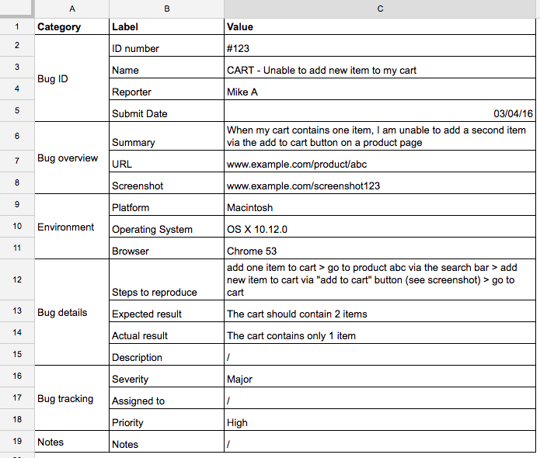
Bug Sample

Slide 27
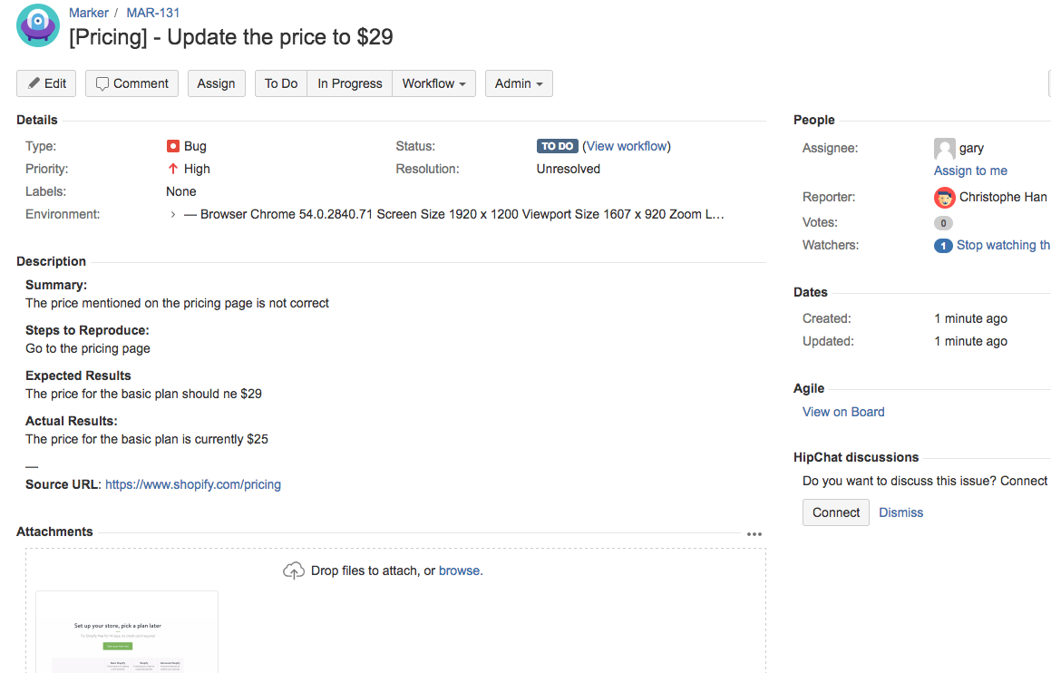

Slide 28
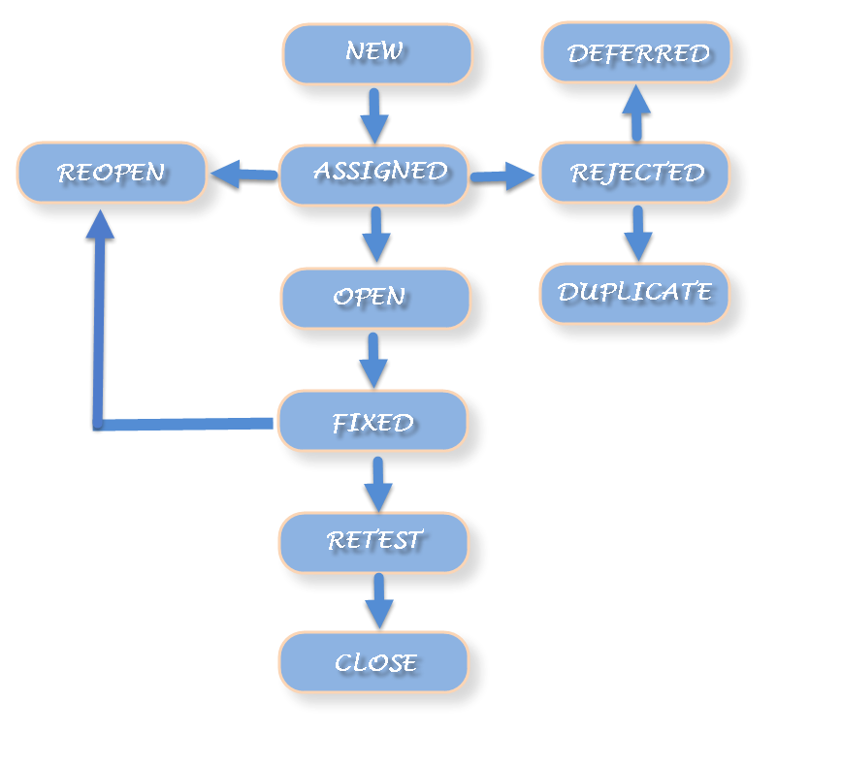
Defect Life Cycle

Slide 29

Summary
A software error is present when the program does not do what its user reasonably expects it to do.
Software Errors usually come from 5 common sources.
There are a lot bugs in a software, however, they are belong to 13 types of software errors.
Bug report is the main product of tester. To write a bug report, the tester has to find, reproduce,
analyze and finally report the bugs.

Slide 30
Corner for you
Based on AB-SD system: choose Login & Logout feature and you will do some tasks as below:
Design test cases for it.
Create test cases for it
Execute test cases and write bugs report with found bugs

Slide 31

Thanks for your listening

